Slide 1



Exploring the Feasibility to make a “Paint Battery”
Andreas Grasser, 26.06.2021

Slide 2

Motivation
Battery production has many steps
In-situ production often impossible
More steps → more expensive
a

Slide 3
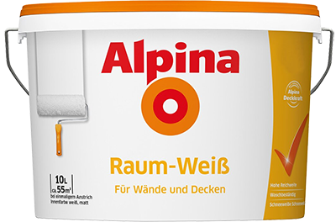
Final goal
One paint that produces the three layers of a battery by itself:
cathode
gel electrolyte / seperator
anode
“Wall paint that forms a battery”
https://www.obi.de

Slide 4
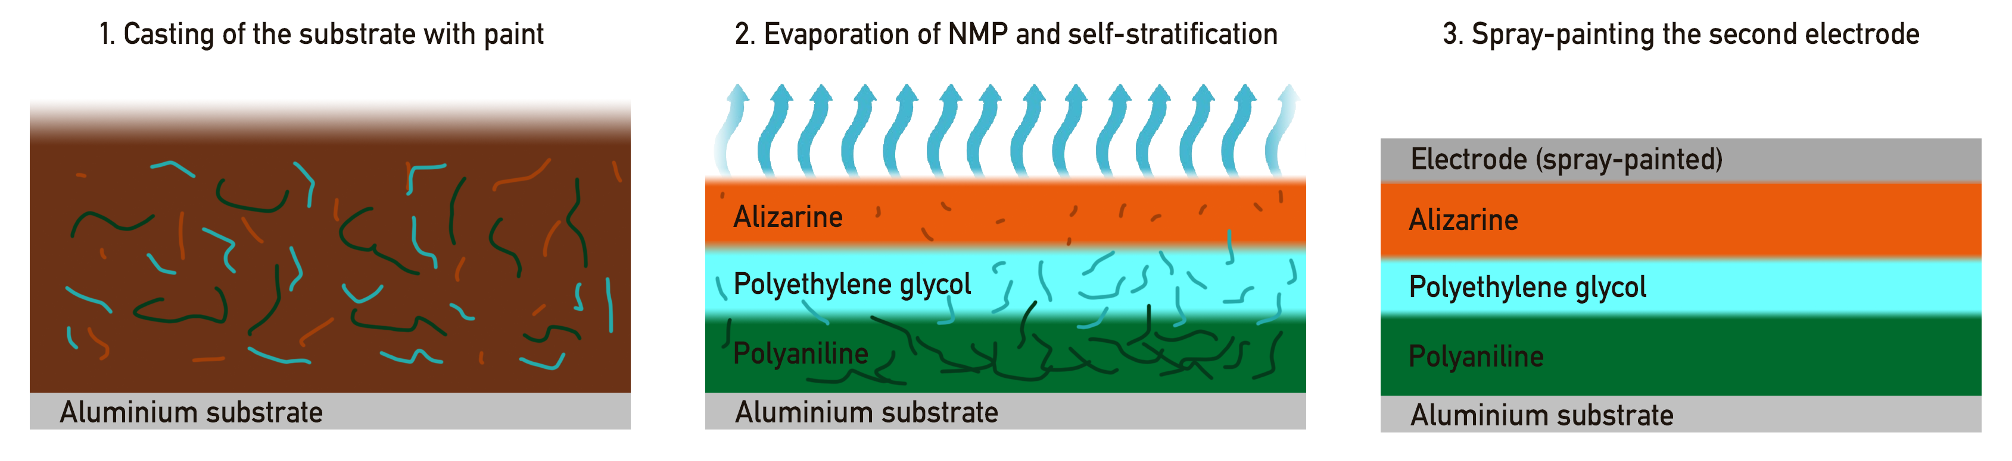
Final goal

Slide 5
Possible steps
Solvability experiments with the components
Simple phase separation experiments
Manually assembled battery using spin-coating etc. for benchmark
“Hybrid” battery with self-stratification of two layers + one spin-coated layer
Complete battery using self stratification
Further improvements
Reality: not that straight forward

Slide 6
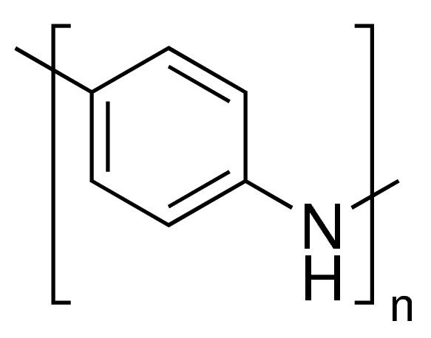
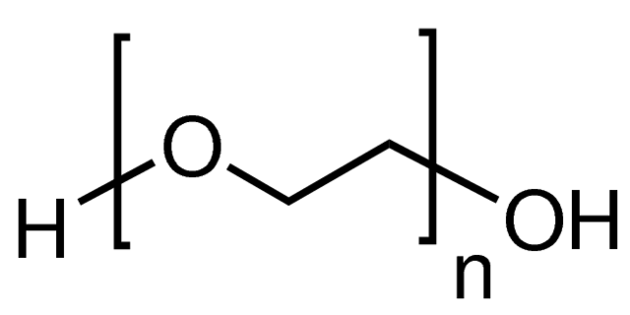
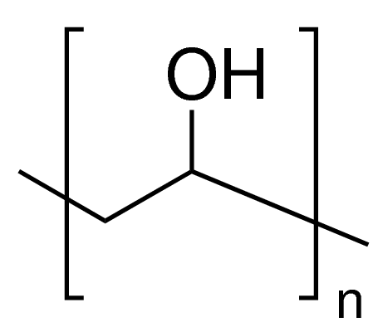
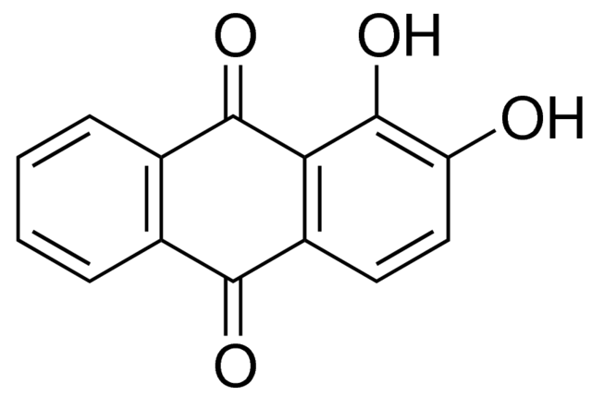
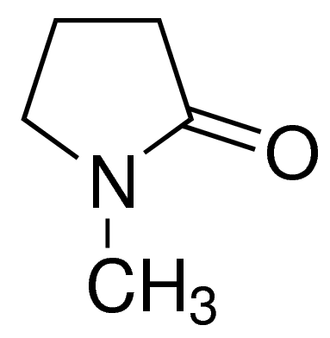
Final goal
Main material focus:
Polyaniline (PANI)
Polyethylene glycol (PEG)
Polyvinyl alcohol (PVA)
Alizarin
N-Methyl-2-pyrrolidone (NMP)
https://www.sigmaaldrich.com

Slide 7
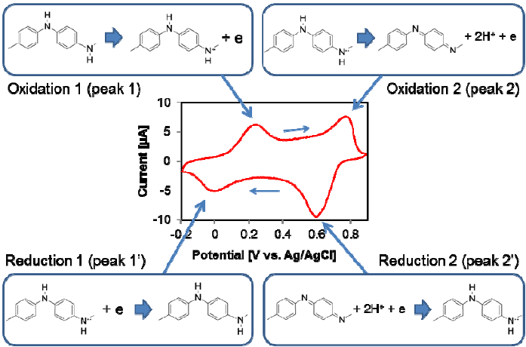
Polyaniline reduction / oxidation
Song, Edward & Choi, Jin-Woo. (2013). Conducting Polyaniline Nanowire and Its Applications in Chemiresistive Sensing. Nanomaterials. 3. 498-523. 10.3390/nano3030498.

Slide 8
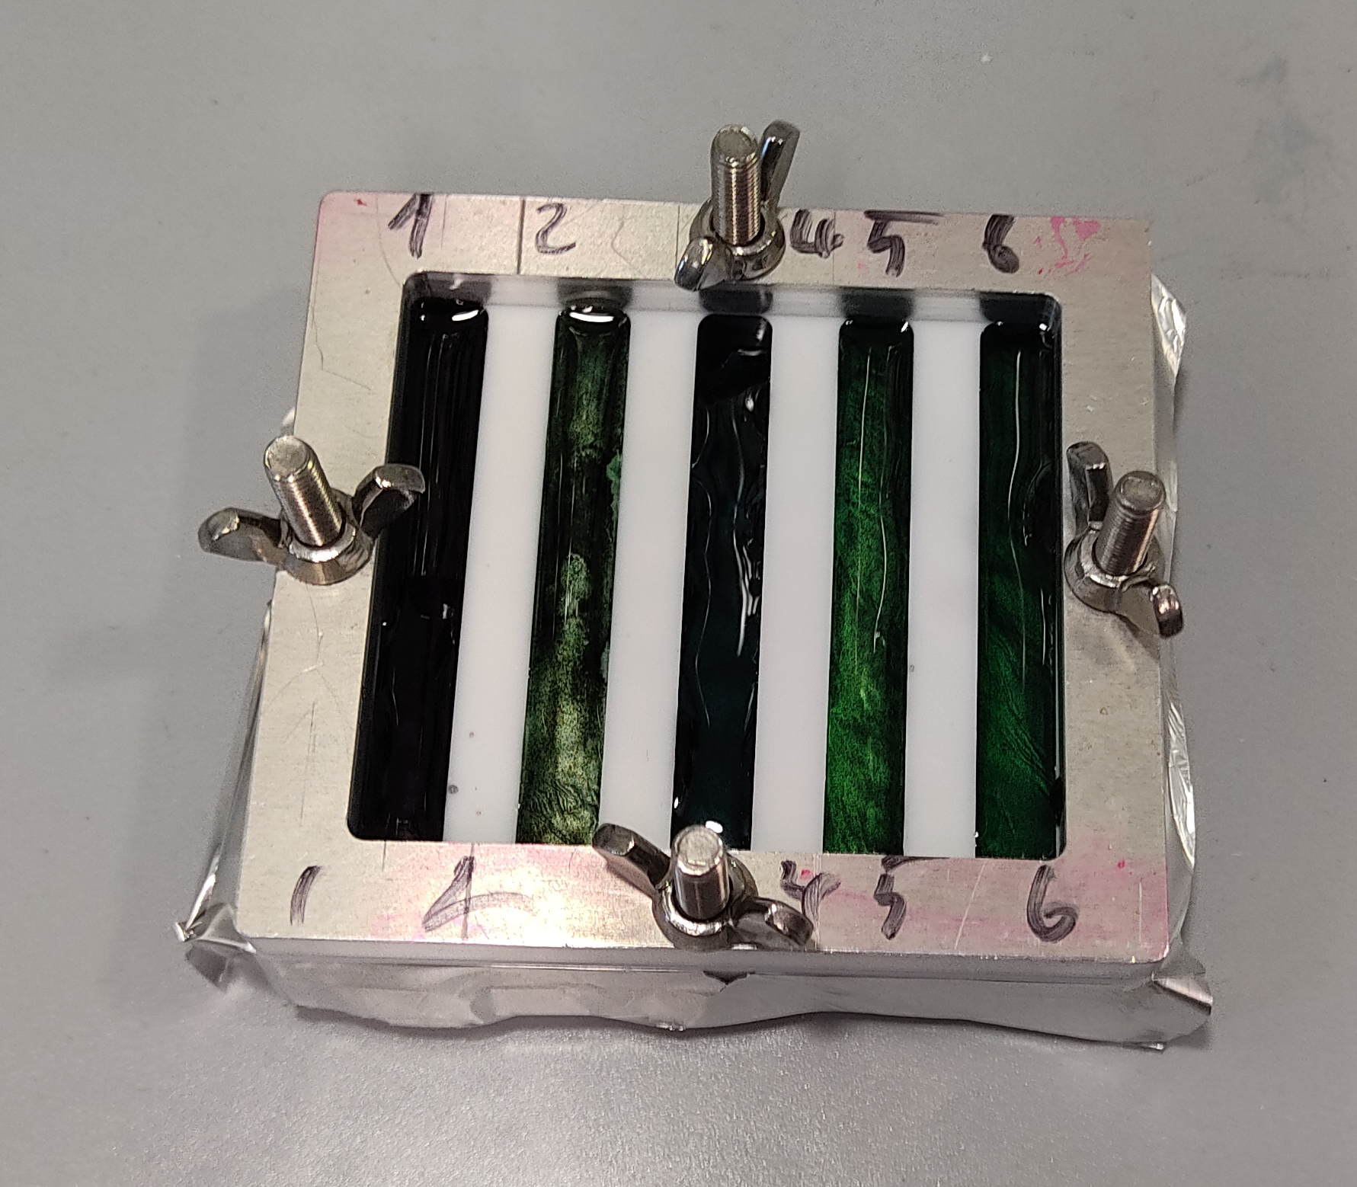
Solvability experiments
One solvent needed for all three polymers
Bottleneck in solvability: PANI
Experiment: PANI with different solvents and different treatments
→ NMP as a good candidate
Solvent has influence on stratification process
Also: PANI with shorter chain length better

Slide 9
Manual Battery
Creating the layers of the battery without self-stratification
Using well-known techniques for battery fabrication
Benchmark for the final battery
Allows to move stepwise towards a complete self stratifying battery

Slide 10
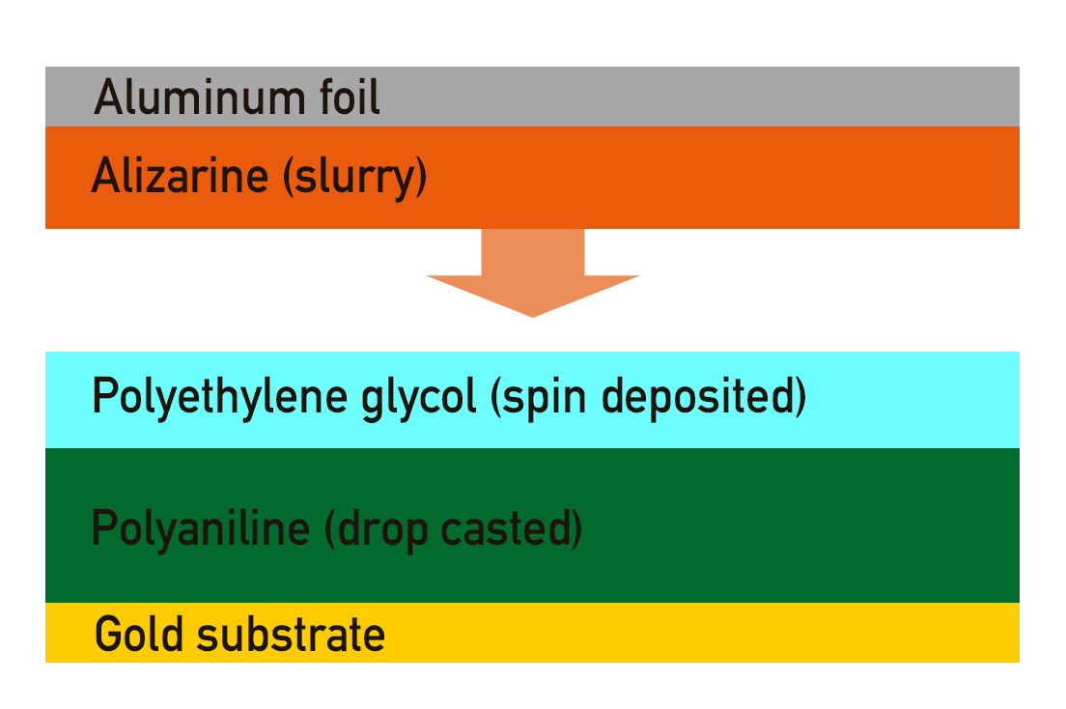
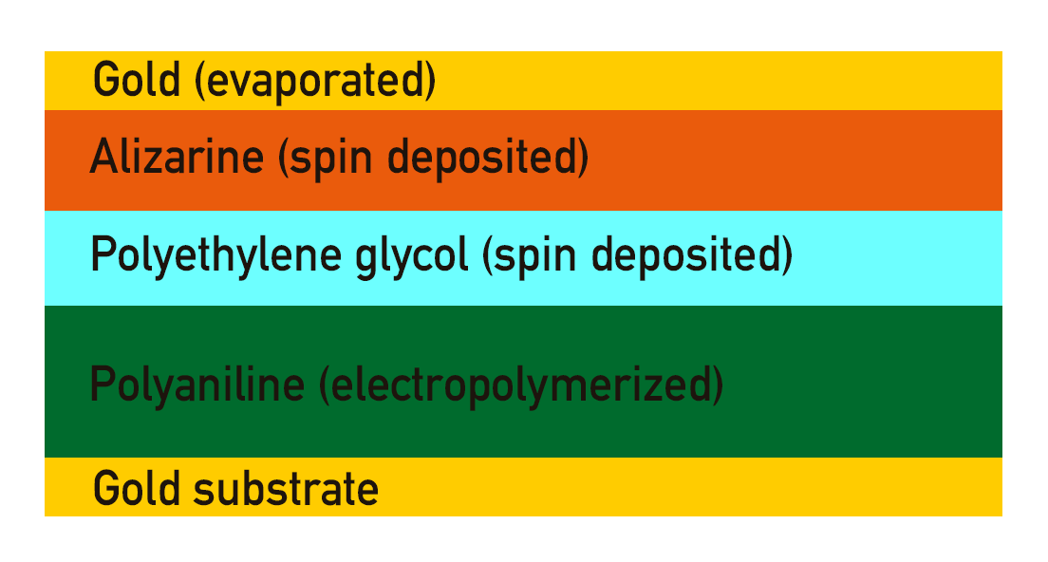
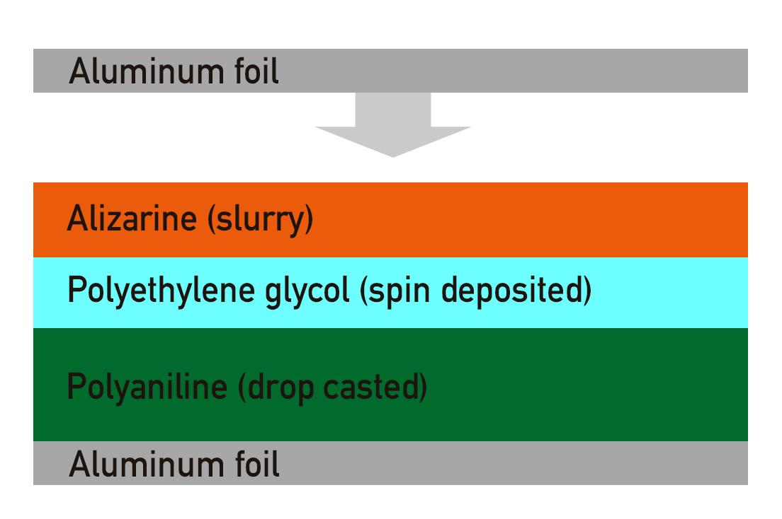
Manual Battery

Slide 11
Manual Battery
Problem: Electropolymerisation of PANI on metal surfaces did not work
Can one dropcast PANI instead of electropolymerize it?
→ CV of drop casted PANI (in 8M NaClO₄)

Slide 12
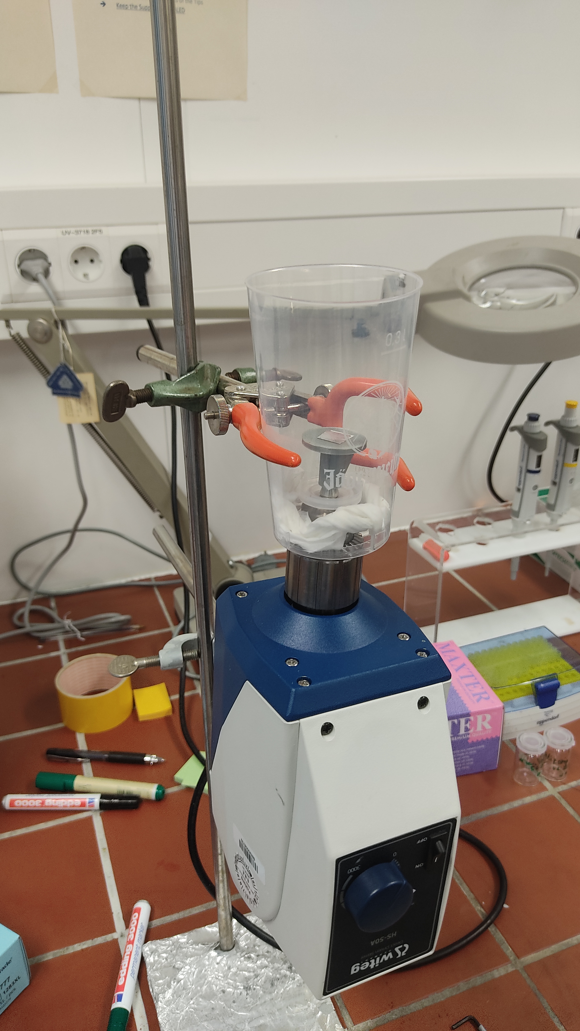
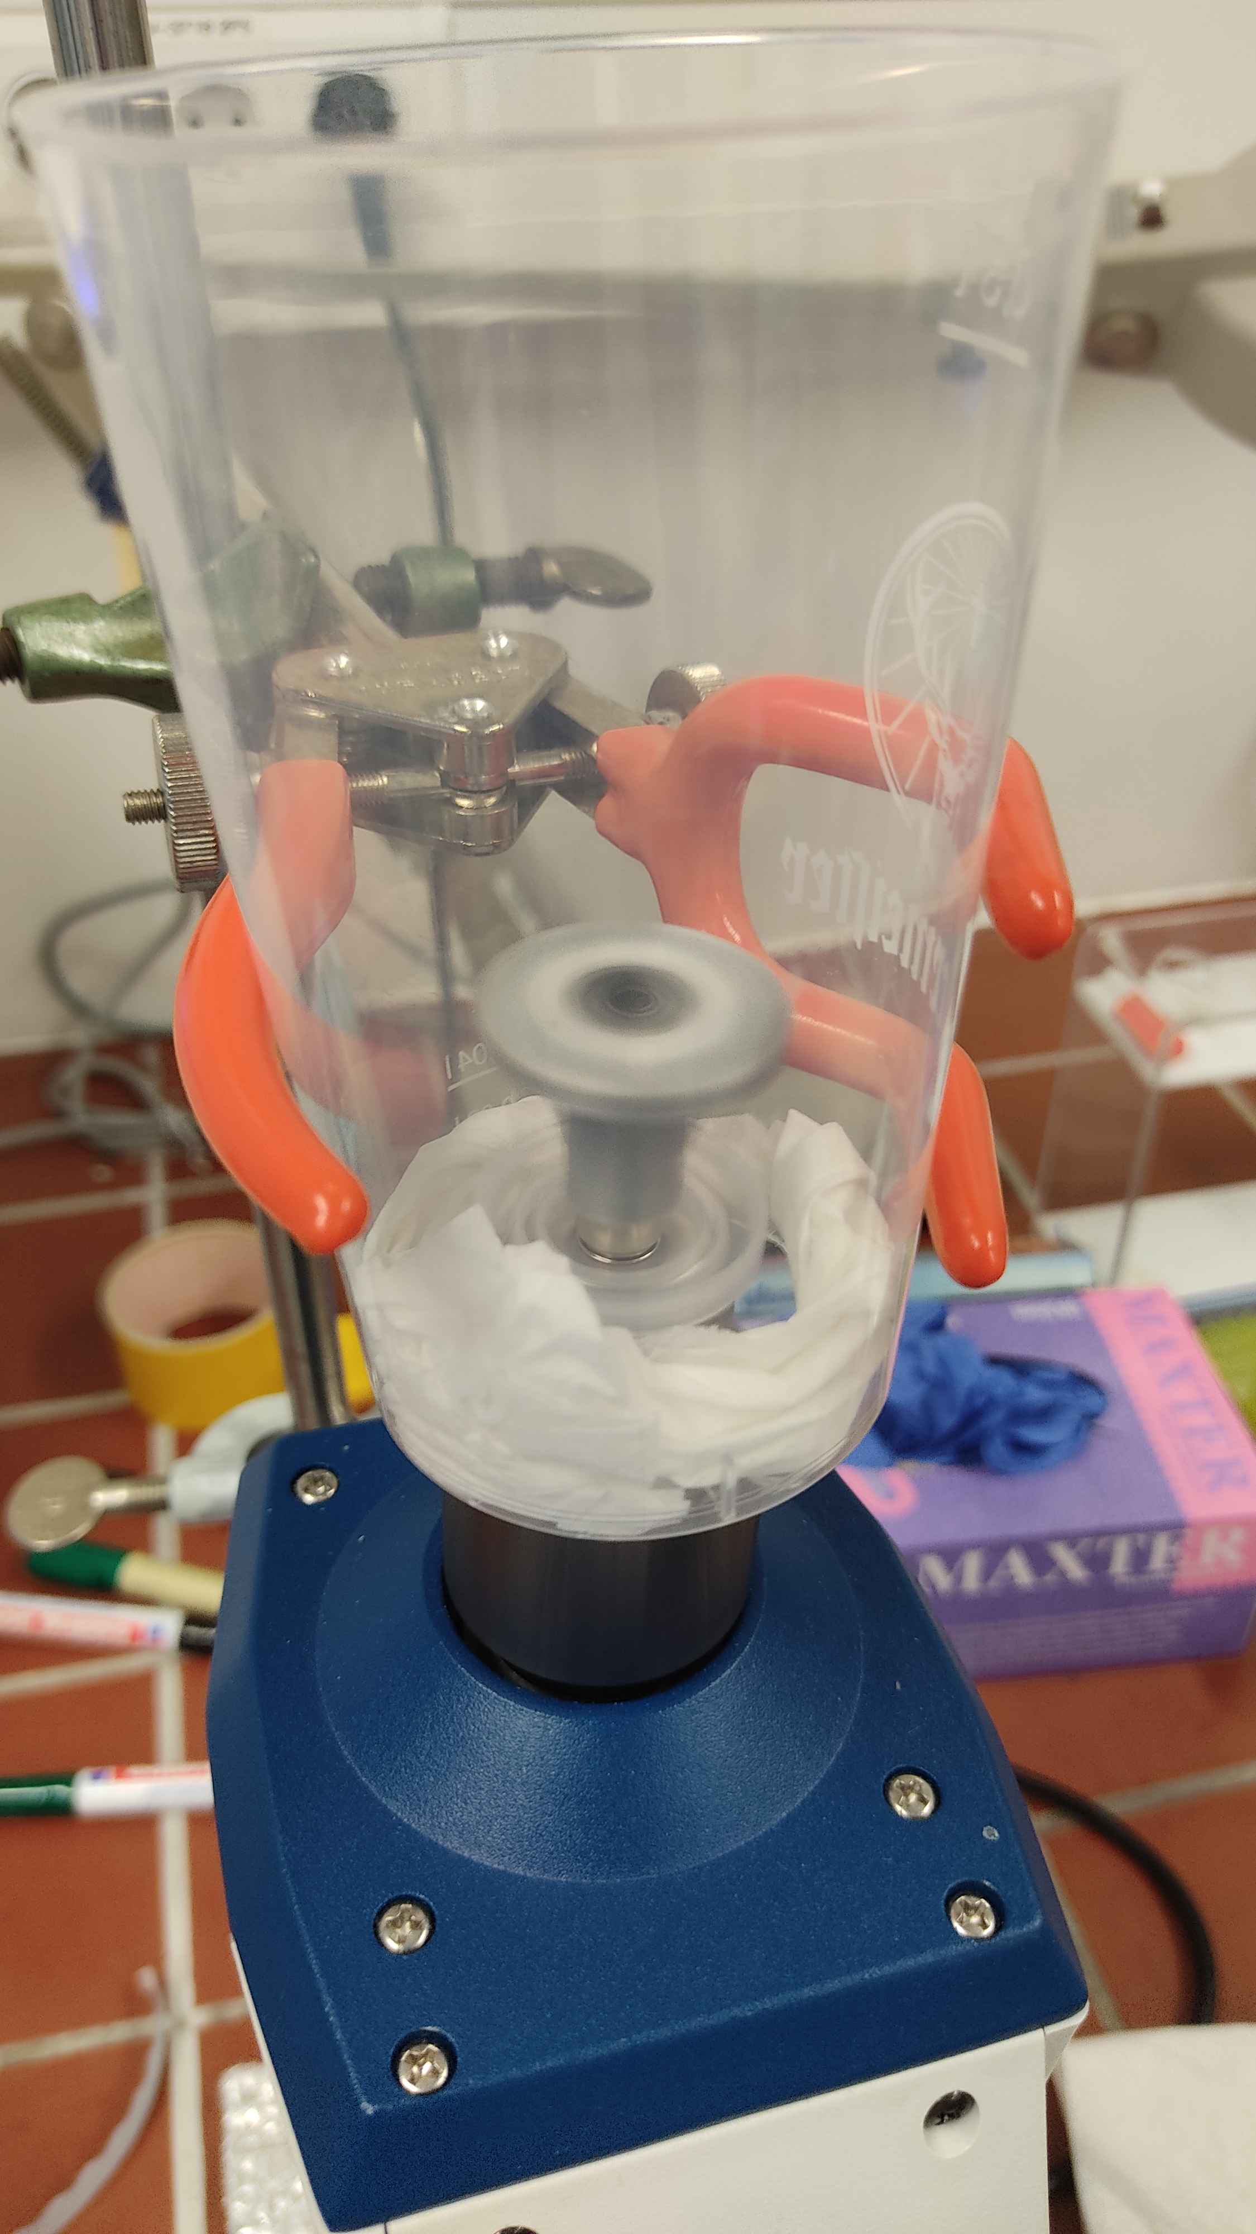
Manual Battery
Using DIY 3D-printed spin coater

Slide 13
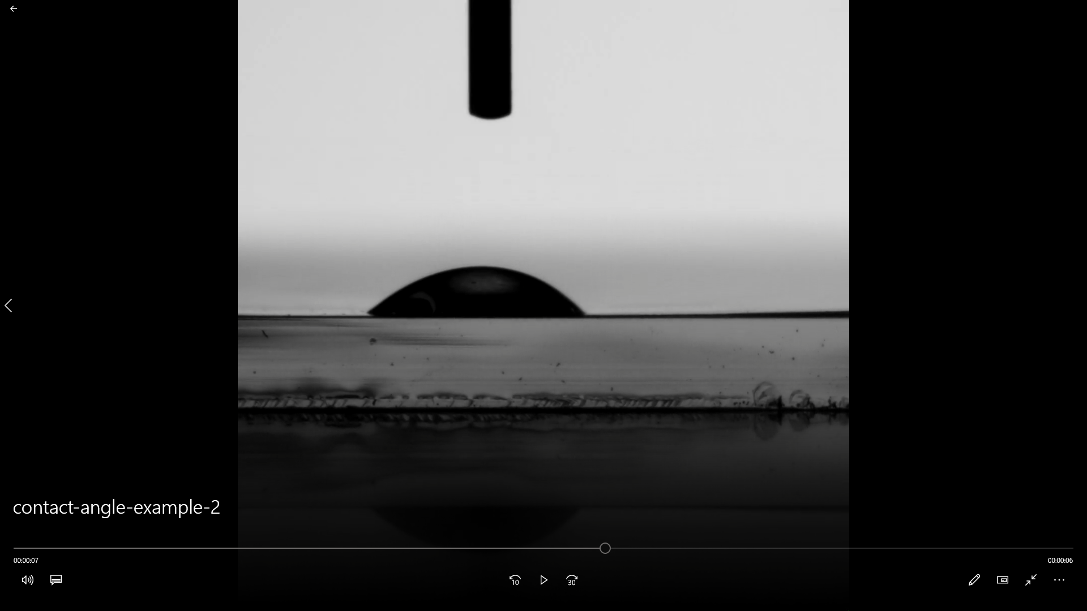
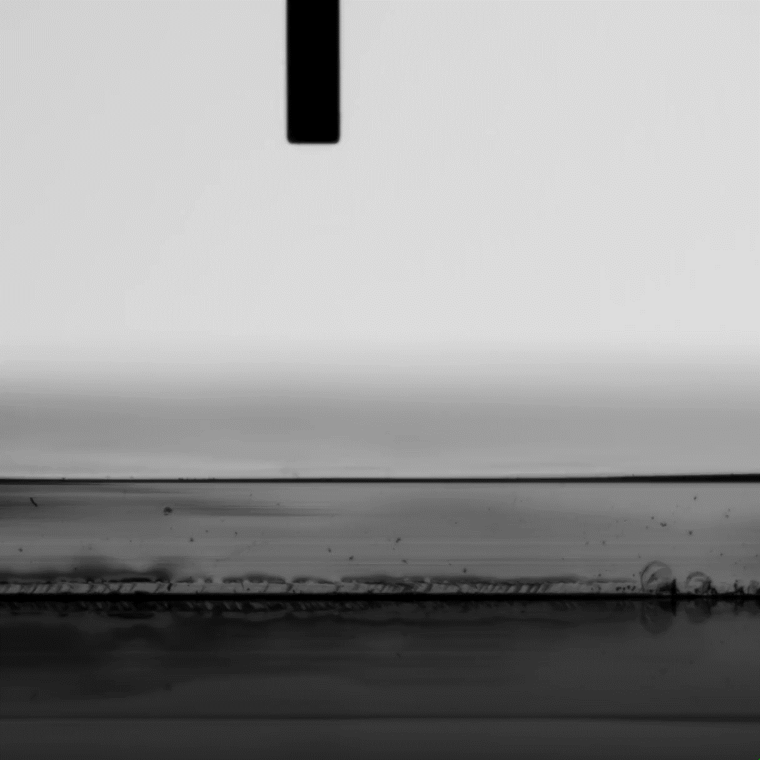
Contact angle measurements
Measure hydrophility of surface
→ possible test for a successful stratification
→ with different liquids: measurement of free surface energy possible
+ Very fast and easy
Many error sources
(soaking into PANI, dirt on surface, different film thickness, …)

Slide 14
Contact angle measurements
Compare contact angle of different samples:
Polyaniline
PVA/PEG
Polyaniline + PVA/PEG
For a successful stratification: contact angle of mixture should show strong tendency towards one of the single components

Slide 15
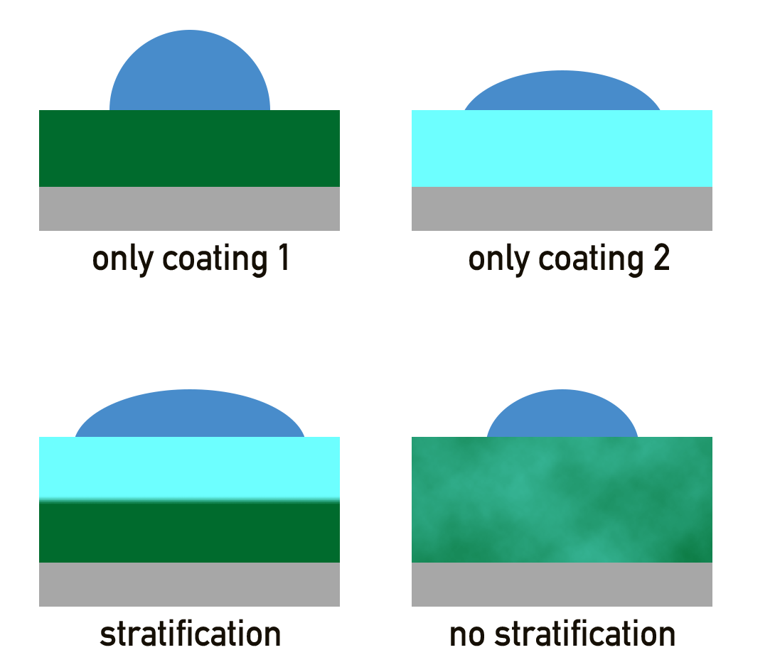
Contact angle measurements

Slide 16
The self-statification process
Driving forces for self-stratification:
Gravity
Selective wetting mechanism
Pigment wetting mechanism
Surface tension gradients
Phase contraction
Two models for predicting self-stratification:
UNIFAC model
Surface energy based model

Slide 17
The surface energy based model
Assumptions:
Surface free energy is main driving force of stratification
Solvent has no influence in stratification
+ Relatively easy to measure and calculate
- Even in an advanced form no perfect prediction possible

Slide 18
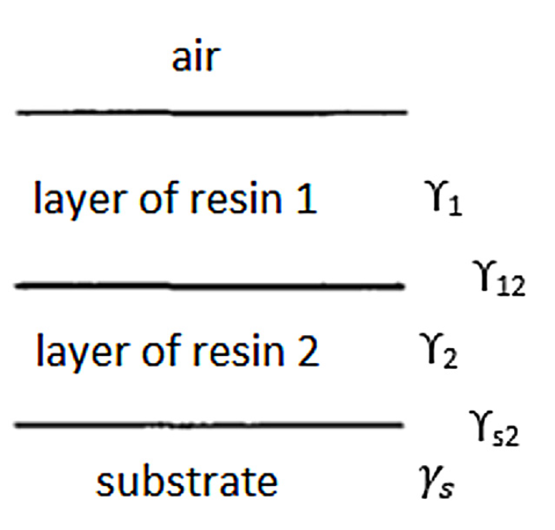
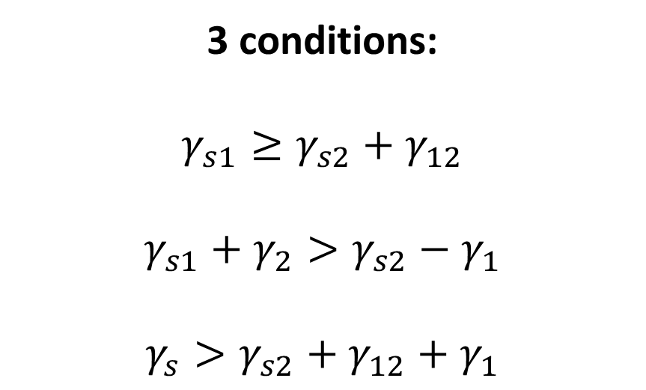
The surface energy based model
3 conditions:
$$γ_{s1}≥γ_{s2}+γ_{12}$$
$$γ_{s1}+γ_{2}>γ_{s2}−γ_{1}$$
$$γ_{s}>γ_{s2}+γ_{12}+γ_{1}$$
Christopher Carr, Eva Wallstöm, Theoretical aspects of self-stratification (1996)
https://doi.org/10.1016/0300-9440(95)00594-3

Slide 19
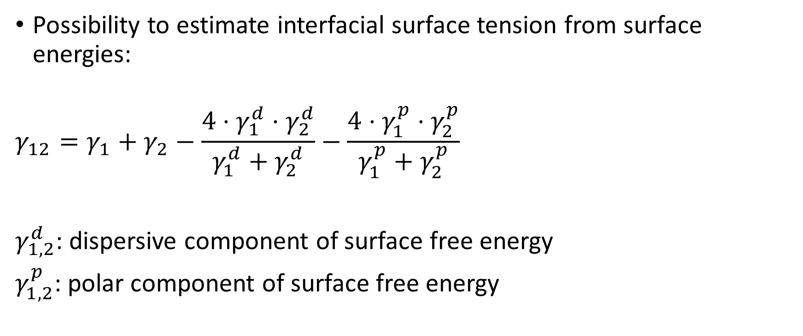
The surface energy based model
Possibility to estimate interfacial surface tension from surface energies:
$$γ_{12}=γ_{1}+γ_{2}−\frac{4⋅γ_{1}^{d}⋅γ_{2}^{d}}{γ_{1}^{d}+γ_{2}^{d}}−\frac{4⋅γ_{1}^{p}⋅γ_{2}^{p}}{γ_{1}^{p}+γ_{2}^{p}}$$
$γ_{1,2}^{d}$: dispersive component of surface free energy
$γ_{1,2}^{p}$: polar component of surface free energy

Slide 20
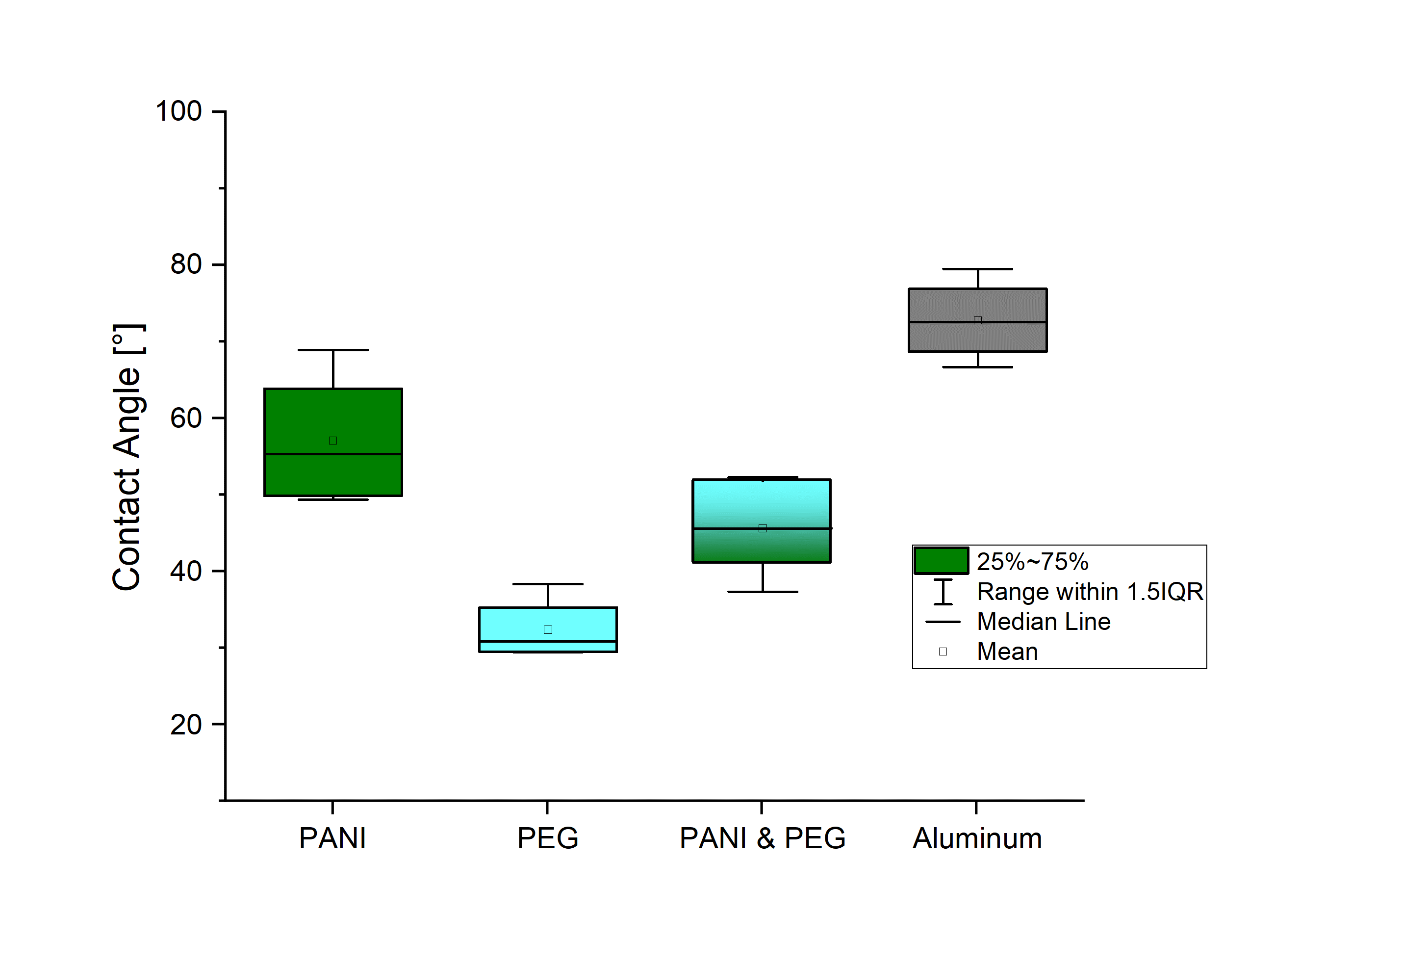
Battery with two layer stratification
No stratification signs for PEG

Slide 21
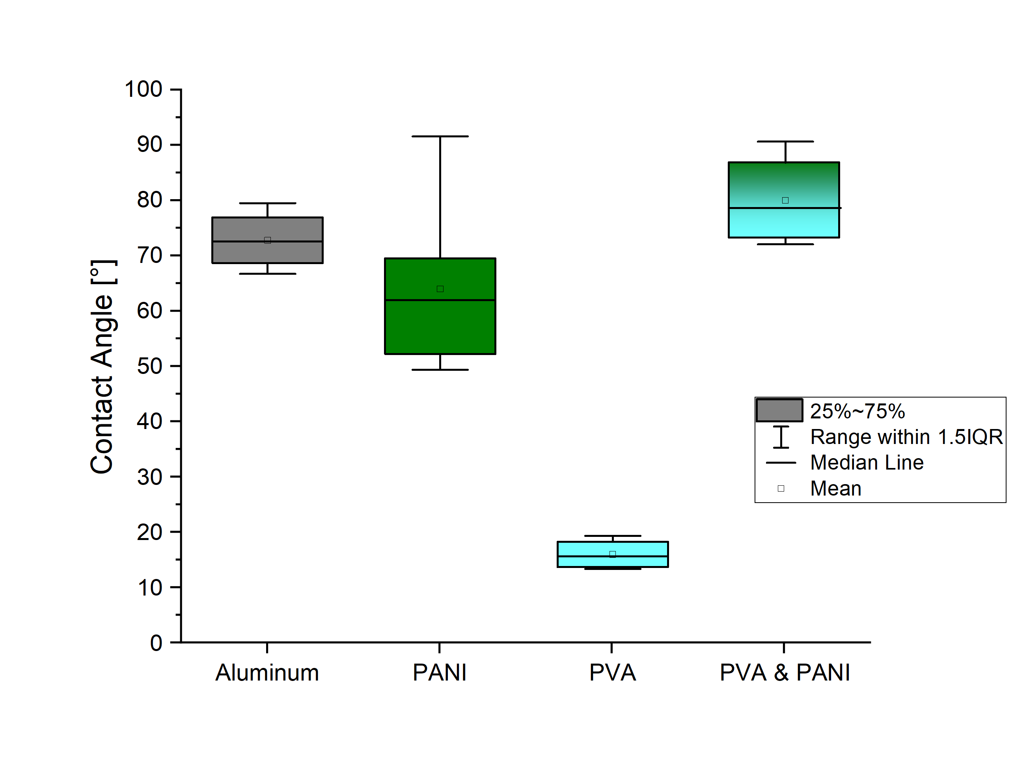
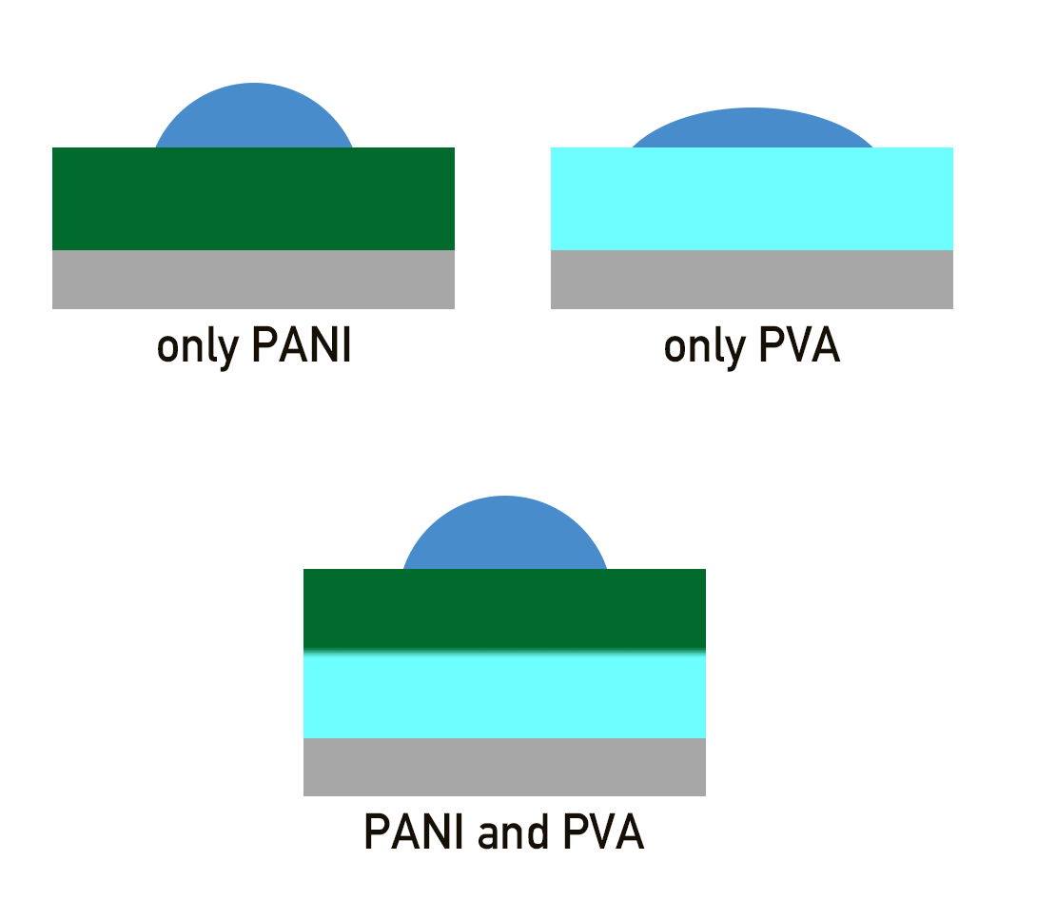
Battery with two layer stratification
Stratification of Polyaniline + PVA on Aluminum foil?

Slide 22
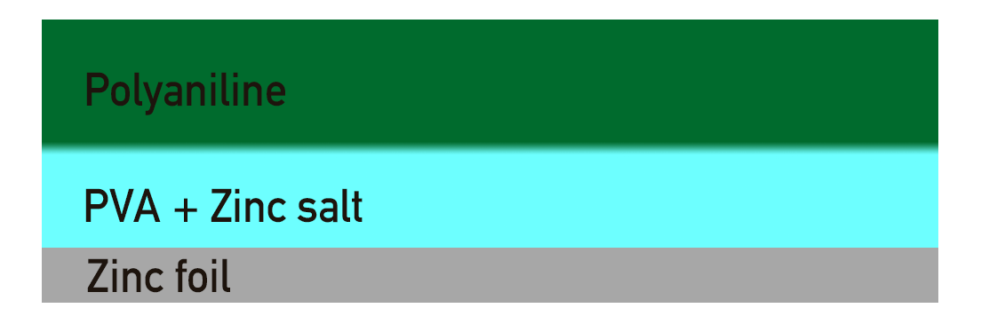
Battery with two layer stratification
Big problem: how to add third layer beneath the coating?
Using a zinc surface as anode and Zinc Perchlorate as conducting salt
Difficulties:
Zinc has different surface energy than Aluminum
Zn²⁺ /Cl⁻ instead of Na⁺ ions

Slide 23
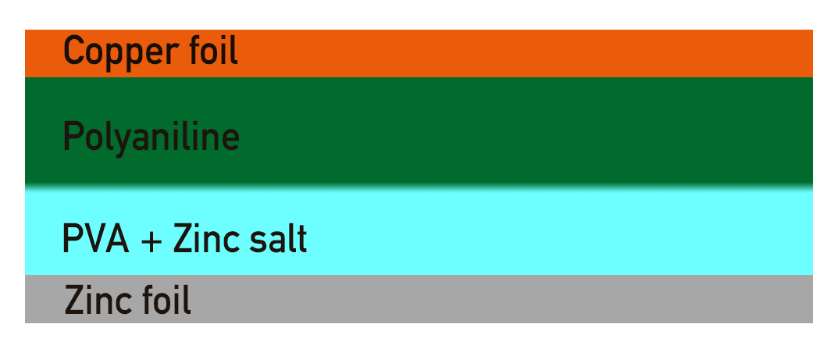
Battery with two layer stratification
First test with copper current collector gave a voltage of ~0.6V
(Reaction directly between zinc ions and copper foil?)

Slide 24
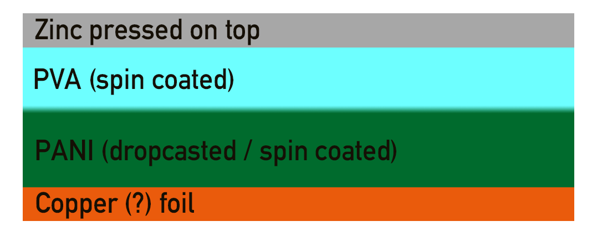
Manual zinc battery
PVA easily solvable in NMP
Spincoating of PANI on top of PVA not possible
Building the battery bottom up

Slide 25
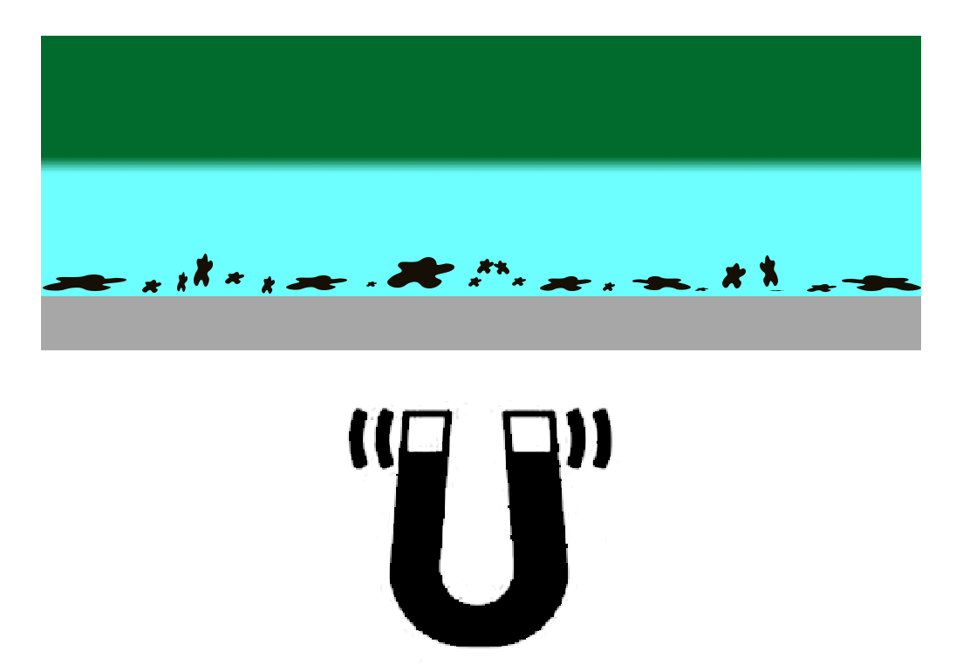
Ways to do three layer stratification
Try stratification by free surface energy mechanism
Not many three-layer stratifications reported in the literature
Complete & reliable stratification is necessary (short circuits!)
Using a magnetic third component to force stratification
…?

Slide 26
Further plan
Build a complete working manual zinc based battery
Determine the surface free energy of the coatings
Use elipsomerty to do advanced testing for self-stratification

